Slide 1


Data Analytics
Introduction to Data Analytics
Class Feb 2024, USA
Mak’Ouma

Slide 2
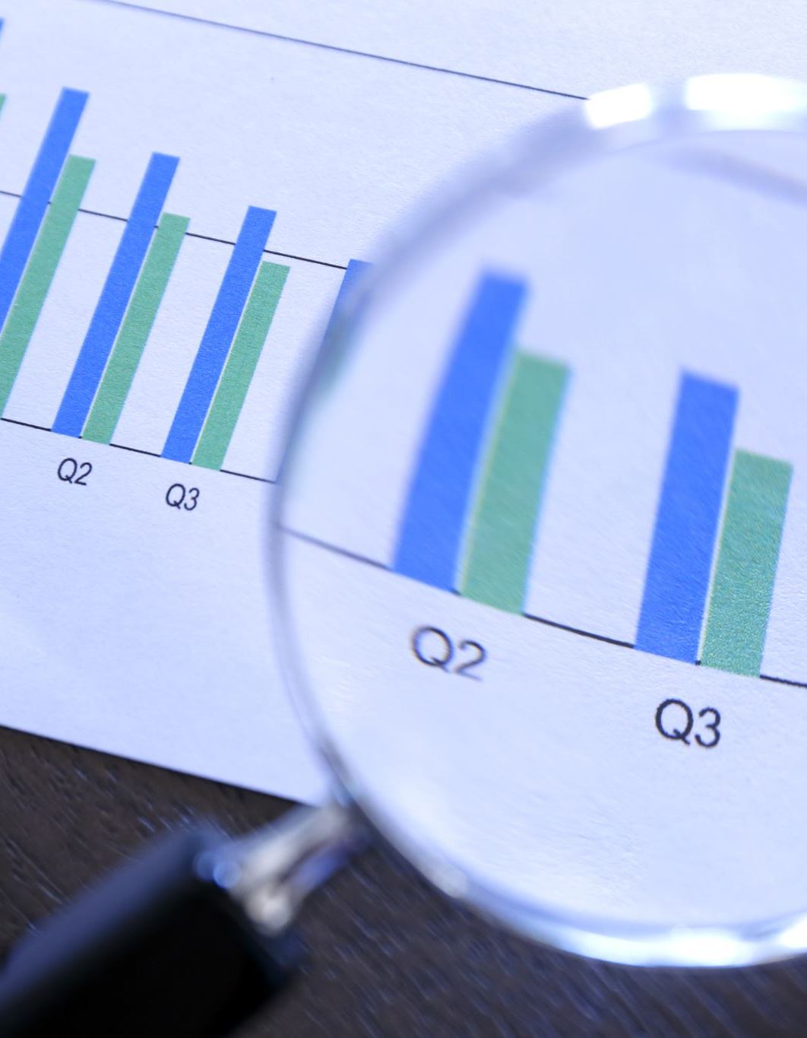
Introduction
Data – facts, characters, quantities, stats, symbols processed, stored and transmitted by computer
Data Analysis - Data analysis is a specialized type of analytics used in businesses to evaluate data and gain insights
Analytics - A process of examining datasets to draw conclusions about the information they contain
Data analytics and Data science
Data analytics tends to focus more on analyzing past data to inform decisions in the present, while data science often involves using data to build models that can predict future outcomes
Data analytics is a better career choice for people who want to start their career in analytics. Data science is a better career choice for those who want to create advanced machine learning models and algorithms

Slide 3
Data Analysis
It is the process of examining, cleaning, transforming, and interpreting data to uncover meaningful patterns, insights, and trends.
It involves using various techniques, tools, and methodologies to extract valuable information from raw data
Data analysis can be performed using both qualitative and quantitative methods.
Qualitative analysis involves interpreting non-numerical data, such as text, images, or video, to identify themes, sentiments, or trends.
Quantitative analysis, on the other hand, deals with numerical data and uses statistical techniques to summarize, analyze, and infer conclusions from the data.

Slide 4
Why Data Analysis
Decision-making: Data analysis provides valuable insights that support informed decision-making.
Problem-solving: Data analysis helps in identifying and solving problems.
Performance evaluation: Data analysis allows organizations to evaluate their performance and measure progress towards goals.
Insights and discoveries: Data analysis can reveal valuable insights and discoveries that may not be immediately apparent.
Risk management: Data analysis plays a crucial role in identifying and mitigating risks.
Customer understanding: Data analysis enables organizations to gain a better understanding of their customers. .
Competitive advantage: In today's data-driven world, organizations that can effectively analyze data have a competitive advantage.

Slide 5

Steps/Process of Data Analysis
Data collection: Gathering relevant data from various sources, such as databases, surveys, experiments, or social media platforms.
Data cleaning: Preprocessing the collected data by removing errors, inconsistencies, duplicates, or missing values. This step ensures that the data is accurate and reliable.
Data exploration: Exploring the dataset through descriptive statistics, data visualization, and other exploratory techniques to gain a better understanding of its characteristics, patterns, and distributions.
Data transformation: Performing data transformations or manipulations, such as aggregating, filtering, or normalizing the data, to prepare it for analysis.
Data modeling: Applying statistical, mathematical, or machine learning techniques to build models that represent the relationships or patterns within the data. Involves hypothesis testing, regression analysis, clustering, classification, or other advanced modeling techniques.
Data interpretation: Interpreting the results obtained from the data analysis to extract meaningful insights, make predictions, or support decision-making processes.
Data visualization and reporting: Presenting the findings of the data analysis using visualizations, charts, graphs, or reports to communicate the results effectively to stakeholders

Slide 6
Types of Data Analysis
Descriptive Analysis: involves summarizing and describing the main features and characteristics of a dataset. It includes measures such as mean, median, mode, range, and standard deviation to provide a basic understanding of the data.
Predictive Analysis: uses historical data to make predictions or forecasts about future events or outcomes. It employs techniques such as regression analysis, time series analysis, and machine learning algorithms to develop models that can predict future behavior.
Prescriptive Analysis: Prescriptive analysis goes beyond predictive analysis and provides recommendations or suggestions for actions to optimize outcomes. It uses optimization algorithms, simulation models, and decision analysis techniques to determine the best course of action based on the predicted outcomes.
Diagnostic Analysis: is aims to understand the causes or factors that contribute to a particular outcome or event. It involves analyzing historical data, conducting root cause analysis, and identifying correlations or causal relationships.

Slide 7
Types of Data Analysis
Inferential Analysis: aims to draw conclusions or make inferences about a population based on a sample. It involves hypothesis testing, confidence intervals, and statistical modeling to generalize findings from the sample to the larger population.
Exploratory Data Analysis (EDA): used to explore and discover patterns, trends, and relationships within a dataset. It involves visualizations, summary statistics, and data profiling techniques to gain insights and generate hypotheses for further analysis.
Text Analysis: Text analysis/text mining or natural language processing (NLP), involves extracting meaningful information and insights from unstructured text data. It includes techniques such as sentiment analysis, topic modeling, and text classification.
Spatial Analysis: focuses on analyzing data that has a geographic component. It involves examining patterns, relationships, and trends in data related to specific locations or areas and geographic information system (GIS) mapping

Slide 8
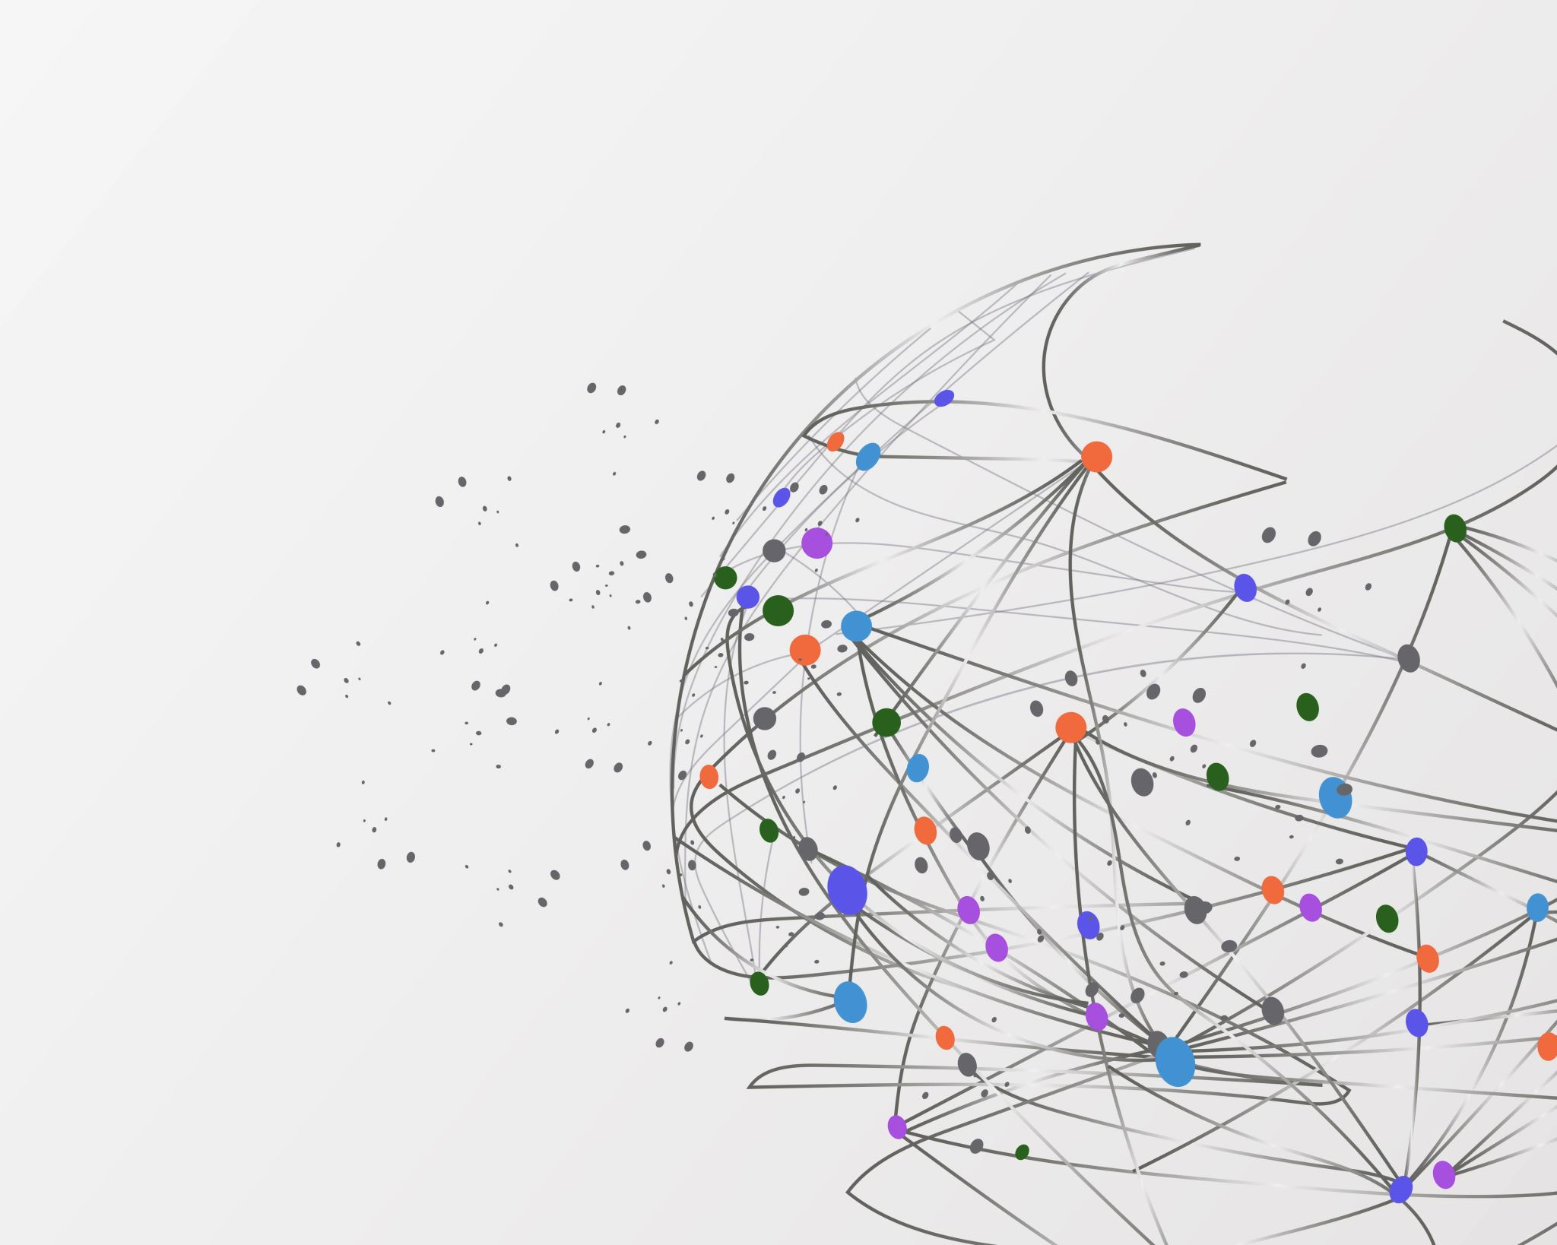
Applications of Data Analysis
Business: Market research, customer segmentation, fraud detection, risk management.
Criminal justice: Crime prediction, recidivism risk assessment, resource allocation.
Healthcare: Disease diagnosis, personalized medicine, drug discovery.
Industry: Predictive maintenance, process optimization, quality control.
Education: Personalized learning, student performance prediction, educational resource development.
Internet of Things (IoT): Sensor data analysis, smart city management, connected devices optimization.
Politics: Voter behavior analysis, campaign optimization, policy evaluation

Slide 9

Case Study 1: Introduction of Data Analysis in Sevenett
Background: Sevenett wants to improve its decision-making processes, optimize inventory management, and enhance customer satisfaction. They realize the potential of data analysis in achieving these goals and decide to introduce data analysis techniques into their operations.
Objective: The objective of this case study is to illustrate how the introduction of data analysis can benefit Sevenett in various aspects of their business.
Suggest the implementation steps you would apply
What would be the results and benefits of implanting this project?

Slide 10

Recap: what are the Key Components of DA
Data Collection: Gathering relevant data from various sources.
Data Preparation: Cleaning, formatting, and organizing data for analysis.
Data Analysis: Applying statistical and machine learning techniques to extract insights.
Data Visualization: Presenting findings in a clear and concise manner

Slide 11

Data Analytics Process
Define Objectives: Clearly articulate the goals of the analysis and identify the key questions to be answered.
Data Collection: Gather relevant data from internal and external sources, ensuring data quality and integrity.
Data Preparation:
Data Cleaning: Identify and correct errors, missing values, and inconsistencies in the data.
Data Transformation: Convert raw data into a format suitable for analysis, such as normalization and feature engineering.
Data Analysis:
Exploratory Data Analysis (EDA): Visualize and explore the data to gain initial insights and identify patterns.
Statistical Analysis: Apply statistical techniques to uncover relationships and correlations within the data.
Machine Learning: Build predictive models to make informed decisions and predictions.
Data Visualization: Present findings using charts, graphs, and dashboards to communicate insights effectively.
Interpretation and Action: Interpret the results of the analysis in the context of the defined objectives and take appropriate actions based on the insights gained.

Slide 12

Tools and Technologies
Data Visualization Tools: Popular tools include Excel, Tableau, Power BI, and matplotlib/seaborn in Python.
Database Management Systems: SQL databases like PostgreSQL and MySQL are commonly used for storing and querying large datasets.
Programming Languages: Python and R are widely used for data analytics due to their rich libraries for data manipulation, analysis, and visualization.
Machine Learning Libraries: Scikit-learn, TensorFlow, and PyTorch provide a wide range of algorithms for building predictive models.

Slide 13

Class Assignment
Why is it now a common norm to see data analysts and scientists holding key organizational positions and being assigned key organizational duties?
The cost(s) associated with a lack of investments in good data analysis are much less in comparison to the missed opportunities to an organization, do you agree with the statement and why?
What are the common effects of poor data quality?

Slide 14

Case Study 2: Data Analysis for Supply Chain Optimization
Background:
A manufacturing company is experiencing challenges in its supply chain management, resulting in inefficiencies, increased costs, and delays in delivering products to customers. They have a wealth of data related to inventory levels, production schedules, transportation, and supplier performance. The company aims to leverage data analysis techniques to identify bottlenecks, optimize inventory management, and improve overall decision-making in the supply chain.
Objective:
The objective is to utilize data analysis to identify areas of improvement within the supply chain, optimize inventory levels, streamline production schedules, and enhance decision-making processes to reduce costs and improve operational efficiency
Explain the approach you will employ to achieve the objective
What are the expected results?

Slide 15

Data Analytics in Decision-Making
Definition: Data analytics in decision-making involves the systematic analysis of data to inform and support the decision-making process across various domains.
Importance: In today's complex and data-rich environment, organizations rely on data analytics to make informed decisions, mitigate risks, seize opportunities, and drive strategic outcomes.
Role of Data Analytics:
Provides insights: Helps uncover patterns, trends, and relationships within data to gain valuable insights.
Improves decision quality: Enables evidence-based decision-making by providing relevant and timely information.
Enhances efficiency: Streamlines decision-making processes and reduces uncertainty through data-driven analysis.
Enables innovation: Facilitates the exploration of new ideas, opportunities, and strategies based on data-driven insights.

Slide 16

Applications of Data Analytics in Decision-Making
Business Decision-Making:
Market analysis: Understand customer preferences, market trends, and competitive dynamics to guide product development and marketing strategies.
Operational optimization: Improve efficiency, resource allocation, and supply chain management to reduce costs and enhance productivity.
Risk management: Identify and mitigate risks related to financial, operational, and strategic decisions.
Healthcare Decision-Making:
Clinical decision support: Assist healthcare professionals in diagnosis, treatment planning, and patient care management.
Public health surveillance: Monitor disease outbreaks, trends in health indicators, and healthcare utilization patterns to inform public health policies and interventions.
Healthcare resource allocation: Optimize resource allocation, capacity planning, and staffing decisions to improve healthcare delivery and patient outcomes.
Financial Decision-Making:
Investment analysis: Evaluate investment opportunities, assess risks, and optimize portfolio allocation based on market trends and financial data.
Credit risk assessment: Assess creditworthiness, predict default probabilities, and manage credit risk in lending and financial services.
Fraud detection: Identify fraudulent activities, anomalies, and patterns indicative of fraudulent behavior to prevent financial losses.

Slide 17

DA Ethical Considerations and Social Implications
Security: Implement measures to protect data from unauthorized access, breaches, and cyber threats.
Privacy and Data Protection: Safeguard individuals' privacy rights and ensure responsible use of personal data in decision-making processes. Ensure the ethical and legal use of data, respecting individuals' privacy rights and maintaining confidentiality.
Bias and Fairness: Address biases in data, algorithms, and decision models to promote fairness, equity, and transparency in decision-making.
Accountability and Transparency: Establish clear accountability mechanisms and transparent decision-making processes to build trust and credibility. Provide transparency in data collection, analysis, and decision-making to build trust and accountability
Social Impact: Consider the broader social, ethical, and environmental implications of decisions and their potential consequences on stakeholders and society.

Slide 18

Tools and Software used in Data Analytics
Importance of Tools and Software: Data analytics relies heavily on specialized tools and software to collect, process, analyze, and visualize data effectively.
Key Considerations: When selecting tools, factors such as ease of use, scalability, compatibility with data sources, and available features play crucial roles in decision-making

Slide 19

Data Collection and Storage Tools
SQL (Structured Query Language) Databases:
Examples: MySQL, PostgreSQL, Microsoft SQL Server
Functionality: Enables efficient storage and retrieval of structured data, supports complex queries and transactions.
NoSQL Databases:
Examples: MongoDB, Cassandra, Redis
Functionality: Ideal for handling unstructured or semi-structured data, offers scalability and flexibility for big data applications.
Data Warehousing Platforms:
Examples: Amazon Redshift, Google BigQuery, Snowflake
Functionality: Designed for storing and analyzing large volumes of structured data, offers scalability, performance, and integration with other cloud services.

Slide 20

Data Preparation and Cleaning Tools
ETL (Extract, Transform, Load) Tools:
Examples: Informatica, Talend, Apache NiFi
Functionality: Facilitates the extraction, transformation, and loading of data from various sources into a unified format for analysis.
Data Cleaning and Wrangling Tools:
Examples: OpenRefine, Trifacta, Dataiku
Functionality: Automates data cleaning tasks such as deduplication, normalization, and missing value imputation, streamlining the data preparation process.

Slide 21
Data Analysis and Modeling Tools
Statistical Analysis Software:
Examples: R, SAS, SPSS
Functionality: Provides a wide range of statistical methods and algorithms for exploratory data analysis, hypothesis testing, and predictive modeling.
Machine Learning Libraries:
Examples: Scikit-learn (Python), TensorFlow, PyTorch
Functionality: Offers algorithms and tools for building and deploying machine learning models for classification, regression, clustering, and more.
Big Data Analytics Platforms:
Examples: Apache Hadoop, Apache Spark, Databricks
Functionality: Enables distributed processing of large-scale datasets across clusters of computers, supporting advanced analytics and machine learning tasks.

Slide 22

Data Visualization Tools
Business Intelligence (BI) Platforms:
Examples: Tableau, Power BI, QlikView
Functionality: Allows users to create interactive dashboards, reports, and visualizations to explore and communicate insights from data.
Programming Libraries for Visualization:
Examples: matplotlib, seaborn (Python), ggplot2 (R)
Functionality: Provides libraries for creating custom visualizations and graphics within programming environments, offering flexibility and control over visualization design.

Slide 23
Integration and Workflow Automation Tools
Workflow Automation Platforms:
Examples: Apache Airflow, Luigi, Prefect
Functionality: Automates and orchestrates data pipelines, workflows, and tasks, ensuring efficient and reliable execution of data analytics processes.
Integration and API Tools:
Examples: Zapier, Segment, MuleSoft
Functionality: Facilitates data integration and interoperability between different systems, applications, and data sources, enabling seamless data flow across the organization.

Slide 24
Considerations for Tool Selection
Scalability: Evaluate whether the tool can handle the volume, velocity, and variety of data required for analytics tasks.
Ease of Use: Consider the tool's user interface, documentation, and support resources to assess its usability for different skill levels.
Cost: Compare the licensing, subscription, and maintenance costs associated with the tool to determine its affordability and value for the organization.
Community and Support: Look for active user communities, forums, and documentation to ensure access to resources and assistance when needed.

Slide 25

Excel for Data Analytics
Overview: Excel is a widely used spreadsheet software developed by Microsoft, known for its versatility, user-friendliness, and extensive functionality in data analysis.
Importance: Despite the availability of more specialized data analytics tools, Excel remains a popular choice for data analysis due to its familiarity, accessibility, and wide range of features.

Slide 26
Key Features and Functionality
Data Entry and Management:
Excel provides a convenient interface for entering, organizing, and managing data in tabular format.
Features like data validation, sorting, filtering, and conditional formatting enhance data management capabilities.
Formulas and Functions:
Excel offers a vast library of built-in formulas and functions for performing various calculations and data manipulation tasks.
Common functions include SUM, AVERAGE, COUNT, IF, VLOOKUP, and CONCATENATE, among others.
Data Analysis Tools:
Excel includes a range of data analysis tools such as pivot tables, data tables, and What-If analysis tools.
Pivot tables allow users to summarize and analyze large datasets by creating interactive tables and charts.
Charting and Visualization:
Excel provides a variety of chart types and customization options for creating visually appealing charts and graphs.
Charts can be embedded within worksheets or exported to other applications for presentation purposes.
Data Modeling and Analysis:
Excel supports basic data modeling and analysis functionalities through features like Data Analysis ToolPak and Solver.
Data Analysis ToolPak offers statistical analysis tools such as regression analysis, correlation, and descriptive statistics.
Solver enables optimization and what-if analysis by finding the optimal solution to complex problems based on specified constraints.

Slide 27
Applications in Data Analytics
Exploratory Data Analysis (EDA):
1
Excel facilitates EDA by providing tools for summarizing data, identifying trends, and visualizing patterns through charts and graphs.
Data Cleaning and Preparation:
2
Excel's filtering, sorting, and conditional formatting capabilities aid in data cleaning and preparation tasks.
Users can easily identify and correct errors, remove duplicates, and format data for analysis.
Statistical Analysis:
3
While Excel may not offer as advanced statistical capabilities as dedicated statistical software, it provides sufficient functionality for basic statistical analysis.
Users can perform descriptive statistics, hypothesis testing, and regression analysis using built-in functions and tools.
Reporting and Presentation:
4
Excel is widely used for creating reports and presentations that summarize analysis results and insights.
Users can leverage Excel's formatting options and charting tools to create professional-looking reports for stakeholders.

Slide 28
Limitations and Considerations
Scalability: Excel may struggle with large datasets or complex analysis tasks due to its memory and processing limitations.
Data Integrity: Excel lacks robust data validation and version control mechanisms, increasing the risk of errors and inconsistencies in analysis.
Reproducibility: Reproducing analysis conducted in Excel can be challenging due to manual processes and lack of documentation.
Collaboration: Collaborating on Excel files can be cumbersome, especially when multiple users need to work on the same dataset simultaneously

Slide 29
Case Study: Streamlining Financial Analysis with Excel
Introduction: XYZ Financial Services, a leading investment firm, aims to streamline its financial analysis processes and improve decision-making by leveraging Excel, a versatile spreadsheet software, for data analytics. The company seeks to analyze investment portfolios, perform risk assessments, and generate actionable insights to optimize investment strategies and maximize returns for clients.
Objective: The primary objective of this project is to use Excel for financial analysis, including portfolio analysis, risk management, and performance evaluation, to drive informed investment decisions and enhance client satisfaction.

Slide 30

Methodology
Data Collection: XYZ Financial Services collects financial data from various sources, including market data providers, client portfolios, and internal databases, including information on asset prices, returns, volatility, and economic indicators.
Data Preparation and Cleaning: The collected financial data is imported into Excel and cleaned to ensure accuracy and consistency. This involves formatting data, handling missing values, and removing outliers.
Data Analysis with Excel:
Portfolio Analysis: Excel is used to perform portfolio analysis, including calculating portfolio returns, volatility, and performance metrics such as Sharpe ratio and alpha.
Risk Management: Excel facilitates risk management through techniques such as Value-at-Risk (VaR) analysis, stress testing, and scenario analysis to assess portfolio risk exposure and develop risk mitigation strategies.
Performance Evaluation: Excel enables performance evaluation by comparing investment returns against benchmarks, analyzing investment attribution, and conducting performance attribution analysis.
Forecasting and Modeling: Excel is utilized for financial forecasting and modeling, including predicting asset prices, simulating investment scenarios, and optimizing portfolio allocations using techniques such as Monte Carlo simulation and optimization.
Insights and Recommendations:
Based on the analysis results, XYZ Financial Services generates actionable insights and recommendations to optimize investment strategies, including:
Adjusting portfolio allocations based on risk-return profiles and market conditions.
Diversifying investments to reduce concentration risk and enhance portfolio resilience.
Implementing hedging strategies to mitigate downside risk and protect against market volatility.
Monitoring performance metrics and rebalancing portfolios to align with investment objectives and client preferences.

Slide 31

Results and Conclusion
Informed Decision-Making: By leveraging Excel for financial analysis, XYZ Financial Services gains deeper insights into investment performance, risk exposure, and market trends, enabling informed decision-making and strategic planning.
Improved Portfolio Performance: Optimizing investment strategies based on Excel analysis results in improved portfolio performance, enhanced risk-adjusted returns, and increased client satisfaction.
Risk Mitigation and Compliance: Excel enables XYZ Financial Services to identify and manage portfolio risks effectively, ensuring compliance with regulatory requirements and safeguarding client assets.
Conclusion: Through the strategic use of Excel for financial analysis, XYZ Financial Services successfully streamlines its investment processes, improves decision-making, and enhances client outcomes. This case study demonstrates the effectiveness of Excel in driving data-driven financial analysis, optimizing investment strategies, and delivering value in the financial services industry

Slide 32

Power BI for Data Analytics
Overview: Power BI is a business analytics tool developed by Microsoft that enables users to visualize and analyze data from various sources to make informed decisions.
Key Features:
Data visualization: Create interactive and visually appealing dashboards, reports, and charts.
Data modeling: Combine and transform data from different sources using Power Query and Power Pivot.
Data analysis: Utilize advanced analytics capabilities such as forecasting, clustering, and sentiment analysis.
Collaboration: Share insights and collaborate with team members through Power BI Service.

Slide 33

Power BI Components
Power BI Desktop:
Desktop application for creating and designing data models, reports, and dashboards.
Features include data importing, data modeling, report authoring, and visualization customization.
Power BI Service:
Web-based platform for publishing, sharing, and collaborating on Power BI content.
Allows users to view and interact with reports and dashboards, schedule data refreshes, and manage access permissions.
Power BI Mobile:
Mobile app for accessing Power BI content on smartphones and tablets.
Provides interactive viewing of reports and dashboards, with support for offline access and notifications.

Slide 34

Key Functionality and Capabilities
Data Connectivity:
Power BI connects to a wide range of data sources, including databases, cloud services, files, and streaming data.
Provides built-in connectors for popular platforms such as SQL Server, Excel, Salesforce, Google Analytics, and more.
Data Preparation:
Power Query allows users to transform and clean data from various sources through a graphical interface.
Power Pivot enables users to create relationships, calculations, and hierarchies within the data model.
Data Visualization:
Power BI offers a rich library of visualizations, including bar charts, line charts, pie charts, maps, tables, and custom visuals.
Users can customize visualizations, apply filters, and create interactive dashboards to explore data insights.
Advanced Analytics:
Power BI integrates with Azure Machine Learning and other advanced analytics services to perform predictive modeling, anomaly detection, and clustering.
Users can leverage built-in AI capabilities such as Q&A (natural language querying) and Key Influencers analysis.
Data Sharing and Collaboration:
Power BI Service allows users to publish reports and dashboards to a secure cloud environment for sharing with colleagues and stakeholders.
Collaboration features include commenting, sharing links, embedding reports in websites, and setting up data-driven alerts.

Slide 35

Applications in Data Analytics
Business Intelligence and Reporting:
Power BI enables organizations to create interactive and insightful reports and dashboards to monitor performance, track KPIs, and gain actionable insights.
Data Exploration and Analysis:
Users can explore large datasets, uncover trends, and identify patterns through interactive visualizations and ad-hoc analysis.
Operational Analytics:
Power BI can be used to analyze operational data in real-time, enabling organizations to monitor processes, detect anomalies, and optimize performance.
Predictive Analytics:
By integrating with machine learning models and statistical algorithms, Power BI supports predictive analytics use cases such as sales forecasting, customer churn prediction, and risk assessment.

Slide 36

Considerations and Best Practices
Continuous Improvement: Regularly review and update Power BI content based on feedback, changing business requirements, and advancements in technology
User Training and Adoption: Provide training and support to users to maximize their proficiency and adoption of Power BI within the organization.
Performance Optimization: Optimize data models, queries, and visualizations to improve report performance and responsiveness.
Data Governance and Security: Establish data governance policies and security measures to ensure the confidentiality, integrity, and availability of data within Power BI.

Slide 37

Case Study: Enhancing Retail Operations with Power BI
Introduction: XYZ Retail, a large chain of supermarkets, seeks to improve its retail operations and enhance customer satisfaction by leveraging data analytics. The company decides to implement Power BI, a leading business intelligence and analytics tool, to analyze sales data, optimize inventory management, and drive strategic decision-making.
Objective: The primary objective of this project is to use Power BI to analyze retail sales data, gain actionable insights, and optimize inventory management processes to improve operational efficiency and customer satisfaction.

Slide 38

Methodology
Data Collection: XYZ Retail collects sales data from its point-of-sale (POS) systems, including transaction details, product information, sales channels, and customer demographics.
Data Integration and Cleaning: The collected sales data is integrated into a centralized data repository and cleaned to ensure accuracy and consistency. This involves data validation, deduplication, and transformation.
Data Analysis and Visualization with Power BI:
Sales Performance Analysis: Power BI dashboards are created to analyze sales performance metrics such as revenue, units sold, and average transaction value across different product categories, stores, and time periods.
Inventory Management Analysis: Power BI visualizations are used to analyze inventory levels, turnover rates, and stockouts to optimize inventory replenishment and reduce carrying costs.
Customer Segmentation: Power BI analyzes customer purchase behavior, preferences, and demographics to segment customers and personalize marketing and promotional efforts.
Market Basket Analysis: Power BI performs market basket analysis to identify product affinities and association rules, enabling cross-selling and upselling opportunities.
Demand Forecasting: Power BI leverages historical sales data to forecast future demand for products, facilitating better inventory planning and procurement decisions.
Insights and Recommendations:
Based on the analysis results, XYZ Retail generates actionable insights and recommendations to improve retail operations, including:
Optimizing product assortment and pricing strategies based on sales performance and customer preferences.
Implementing dynamic pricing and promotions to drive sales and maximize revenue.
Streamlining inventory management processes and reducing stockouts through better demand forecasting and replenishment strategies.
Enhancing customer engagement and loyalty through personalized marketing campaigns and targeted promotions.

Slide 39

Results and Conclusion
Improved Operational Efficiency: By leveraging Power BI for data analysis and visualization, XYZ Retail achieves greater visibility into sales performance, inventory levels, and customer behavior, leading to improved operational efficiency and decision-making.
Increased Revenue and Profitability: Optimizing retail operations based on Power BI insights results in increased sales, higher margins, and improved profitability for XYZ Retail.
Enhanced Customer Satisfaction: With personalized marketing efforts, optimized product offerings, and improved inventory availability, XYZ Retail enhances customer satisfaction and loyalty, driving repeat business and positive word-of-mouth.
Conclusion: Through the strategic implementation of Power BI for data analytics and visualization, XYZ Retail successfully enhances its retail operations, improves customer satisfaction, and achieves business growth. This case study demonstrates the effectiveness of Power BI in driving data-driven decision-making, optimizing retail operations, and delivering tangible business results in the retail industry.

Slide 40

Tableau for Data Analytics
Overview: Tableau is a leading data visualization and analytics platform that empowers users to explore, analyze, and visualize data to uncover insights and make data-driven decisions.
Key Features:
Intuitive drag-and-drop interface for creating interactive visualizations.
Seamless connectivity to various data sources, including databases, spreadsheets, and cloud services.
Advanced analytics capabilities for predictive modeling, forecasting, and trend analysis.
Sharing and collaboration features through Tableau Server or Tableau Online.

Slide 41
Tableau Products
Tableau Desktop:
Desktop application for creating and designing interactive dashboards, reports, and visualizations.
Features include data connection, data preparation, visualization design, and dashboard creation.
Tableau Server:
Enterprise-grade platform for publishing, sharing, and managing Tableau content within an organization.
Provides centralized data governance, security, and scalability for large-scale deployments.
Tableau Online:
Cloud-based version of Tableau Server hosted by Tableau, offering similar functionality for sharing and collaboration.
Ideal for organizations looking for a scalable and low-maintenance solution without the need for on-premises infrastructure.

Slide 42
Key Functionality and Capabilities
Data Connection and Preparation:
Tableau allows users to connect to a wide range of data sources, including databases, spreadsheets, web data connectors, and cloud services.
Data preparation features enable users to clean, shape, and transform data within Tableau for analysis.
Data Visualization:
Tableau offers a rich library of visualization types, including bar charts, line charts, scatter plots, maps, and dashboards.
Users can easily create interactive visualizations by dragging and dropping fields onto the canvas and configuring properties.
Advanced Analytics:
Tableau integrates with R and Python for advanced analytics and predictive modeling, allowing users to leverage custom scripts and algorithms.
Built-in statistical functions and calculations enable users to perform trend analysis, forecasting, and clustering within Tableau.
Dashboard Design and Interactivity:
Tableau enables users to create interactive dashboards that combine multiple visualizations into a single view.
Dashboard elements can be linked together to facilitate drill-down, filtering, and exploration of data insights.

Slide 43
Applications in Data Analytics
Business Intelligence and Reporting:
Tableau is widely used for business intelligence and reporting, allowing organizations to monitor performance, analyze trends, and track KPIs through interactive dashboards and reports.
Exploratory Data Analysis (EDA):
Users can explore and analyze large datasets quickly using Tableau's intuitive interface and powerful visualizations, uncovering insights and identifying patterns.
Predictive Analytics and Forecasting:
Tableau's integration with R and Python enables users to perform predictive analytics tasks such as regression analysis, time series forecasting, and predictive modeling.
Operational Analytics:
Tableau can be used for operational analytics to monitor real-time data streams, detect anomalies, and optimize processes for efficiency and performance.

Slide 44
Considerations and Best Practices
Data Governance and Security: Implement data governance policies and security measures to ensure the integrity and confidentiality of data within Tableau.
Performance Optimization: Optimize Tableau workbooks, data connections, and visualizations to improve performance and responsiveness, especially with large datasets.
User Training and Adoption: Provide training and support to users to enhance their proficiency and adoption of Tableau within the organization.
Collaboration and Knowledge Sharing: Encourage collaboration and knowledge sharing among Tableau users through user groups, forums, and internal communities

Slide 45
Case Study: Enhancing Marketing Strategies with Tableau
Introduction: XYZ Marketing Agency, a leading digital marketing firm, aims to optimize its marketing strategies to improve client ROI (Return on Investment) and campaign performance. The agency decides to leverage Tableau, a powerful data visualization tool, to analyze campaign data, identify key trends, and make data-driven decisions to enhance marketing effectiveness.
Objective: The primary objective of this project is to use Tableau to analyze marketing campaign data, gain actionable insights, and optimize marketing strategies to improve client ROI and campaign performance.

Slide 46
Methodology
Data Collection: XYZ Marketing Agency gathers campaign data from various sources, including website analytics, social media platforms, email marketing tools, and customer relationship management (CRM) systems.
Data Integration and Cleaning: The collected data is integrated into a centralized data warehouse and cleaned to ensure accuracy and consistency. This involves handling missing values, removing duplicates, and standardizing data formats.
Data Analysis and Visualization with Tableau:
Campaign Performance Analysis: Tableau is used to analyze campaign performance metrics such as click-through rates, conversion rates, and cost per acquisition (CPA) across different channels and campaigns.
Customer Segmentation: Tableau visualizations segment customers based on demographics, behavior, and engagement metrics to better understand target audiences and personalize marketing efforts.
Attribution Modeling: Tableau is utilized to perform attribution modeling to determine the effectiveness of various marketing channels and touchpoints in driving conversions and sales.
ROI Analysis: Tableau dashboards calculate and visualize the ROI of marketing campaigns, allowing XYZ Marketing Agency to identify high-performing campaigns and allocate budget resources effectively.
A/B Testing Analysis: Tableau helps conduct A/B testing analysis to compare the performance of different marketing creatives, messages, or strategies and optimize campaign elements for better results.
Insights and Recommendations:
Based on the analysis results, XYZ Marketing Agency generates actionable insights and recommendations to optimize marketing strategies, including:
Adjusting budget allocations to high-performing channels and campaigns.
Tailoring messaging and content based on customer segmentation insights.
Testing and iterating on campaign elements to improve performance.
Identifying opportunities for cross-channel optimization and integrated marketing efforts.

Slide 47

Results and Conclusion
Improved Campaign Performance: By leveraging Tableau for data analysis and visualization, XYZ Marketing Agency achieves a deeper understanding of campaign performance drivers and identifies areas for improvement, resulting in enhanced campaign effectiveness and ROI for clients.
Enhanced Decision-Making: Tableau dashboards provide real-time visibility into marketing performance metrics, enabling informed decision-making and agile optimization of marketing strategies based on data-driven insights.
Client Satisfaction and Retention: With optimized marketing strategies and improved campaign performance, XYZ Marketing Agency strengthens client relationships, increases client satisfaction, and enhances client retention rates.
Conclusion: Through the strategic use of Tableau for data analytics and visualization, XYZ Marketing Agency successfully optimizes its marketing strategies, improves campaign performance, and delivers greater ROI for clients. This case study demonstrates the effectiveness of Tableau in driving data-driven decision-making, enhancing marketing effectiveness, and achieving business success in the digital marketing industry.

Slide 48

SQL for Data Analytics
Overview: SQL (Structured Query Language) is a powerful programming language used for managing and manipulating relational databases.
Key Features:
Data Querying: Allows users to retrieve data from databases using SELECT statements.
Data Manipulation: Enables users to insert, update, and delete data in databases using INSERT, UPDATE, and DELETE statements.
Data Definition: Supports the creation, modification, and deletion of database objects such as tables, views, and indexes using CREATE, ALTER, and DROP statements.
Data Control: Facilitates the management of user access privileges and permissions using GRANT and REVOKE statements.

Slide 49

SQL Components
Data Querying:
SELECT statement: Used to retrieve data from one or more tables based on specified criteria.
WHERE clause: Filters rows based on specified conditions.
JOIN operations: Combines data from multiple tables using various join types such as INNER JOIN, LEFT JOIN, and RIGHT JOIN.
Data Manipulation:
INSERT statement: Adds new rows of data into a table.
UPDATE statement: Modifies existing data in a table based on specified criteria.
DELETE statement: Removes rows of data from a table based on specified conditions.
Data Definition:
CREATE statement: Creates new database objects such as tables, views, indexes, and stored procedures.
ALTER statement: Modifies the structure of existing database objects.
DROP statement: Deletes existing database objects from the database.
Data Control:
GRANT statement: Assigns specific privileges to users or roles for accessing and manipulating database objects.
REVOKE statement: Removes previously granted privileges from users or roles.

Slide 50
Applications in Data Analytics
Data Retrieval and Analysis:
SQL is used extensively in data analytics for querying and analyzing large datasets stored in relational databases.
Analysts use SQL to extract relevant data subsets, perform aggregations, calculate metrics, and generate reports.
Data Cleaning and Transformation:
SQL can be used to clean and transform raw data by filtering out irrelevant records, standardizing formats, and aggregating data for analysis.
Analysts can use SQL to perform data validation, deduplication, and data enrichment tasks.
Data Integration and Migration:
SQL is utilized in data integration projects to merge data from disparate sources, transform data formats, and load data into a centralized data warehouse.
Analysts can write SQL scripts to perform data migration tasks such as transferring data between databases or data warehouses.
Data Exploration and Visualization:
SQL queries are often used to extract data for exploration and visualization in data analytics tools such as Tableau, Power BI, or Python libraries like Pandas and Matplotlib.
Analysts can use SQL to retrieve data subsets for generating charts, graphs, and dashboards to visualize trends and patterns.

Slide 51
Best Practices and Considerations
Optimization: Write efficient SQL queries by optimizing indexes, avoiding unnecessary joins, and limiting the use of wildcard characters.
Security: Implement proper security measures to prevent SQL injection attacks and unauthorized access to sensitive data.
Documentation: Document SQL queries, scripts, and database schemas to facilitate collaboration and knowledge sharing among team members.
Version Control: Use version control systems to manage SQL scripts and changes to database structures, ensuring traceability and accountability

Slide 52
Case Study: SQL in Data Analytics
Optimizing Inventory Management with SQL
Introduction: ABC Retail, a leading e-commerce company, is facing challenges in managing its inventory efficiently. The company's inventory system is struggling to keep up with the increasing demand and is prone to overstocking or stockouts, leading to revenue loss and customer dissatisfaction. To address these challenges, ABC Retail decides to leverage SQL for optimizing its inventory management processes.
Objective: The primary objective of this project is to use SQL to analyze historical sales data and optimize inventory levels to meet customer demand while minimizing excess inventory and stockouts.

Slide 53
Methodology:
Data Collection: ABC Retail gathers historical sales data from its database, including information on product sales, inventory levels, and customer orders.
Data Cleaning and Preparation: The data is cleaned and prepared for analysis, including handling missing values, removing duplicates, and standardizing data formats.
Data Analysis with SQL:
Sales Analysis: SQL queries are used to analyze sales trends, identify top-selling products, and forecast demand for each product category.
Inventory Analysis: SQL queries are employed to analyze inventory levels, identify slow-moving or excess stock items, and calculate inventory turnover ratios.
Customer Segmentation: SQL queries segment customers based on their purchasing behavior, preferences, and order frequency to better understand demand patterns.
Supplier Analysis: SQL queries are used to analyze supplier performance, lead times, and purchase orders to optimize procurement processes.
Optimization Recommendations:
Based on the analysis results, ABC Retail develops optimization recommendations to improve inventory management, including:
Adjusting reorder points and reorder quantities based on demand forecasts.
Implementing just-in-time inventory practices to reduce excess inventory and carrying costs.
Identifying opportunities for product bundling, promotions, or discounts to stimulate demand.
Improving supplier relationships and negotiating favorable terms to minimize lead times and stockouts.

Slide 54
Results and Conclusion:
Improved Inventory Accuracy: By leveraging SQL for inventory analysis, ABC Retail achieves greater accuracy in forecasting demand and managing inventory levels, leading to reduced stockouts and excess inventory.
Cost Savings: Optimizing inventory levels and procurement processes results in cost savings for ABC Retail by minimizing carrying costs, reducing inventory write-offs, and avoiding rush orders.
Enhanced Customer Satisfaction: With optimized inventory management practices, ABC Retail can fulfill customer orders more efficiently, reduce delivery lead times, and ensure product availability, leading to improved customer satisfaction and loyalty.
Conclusion: Through the strategic use of SQL for data analytics, ABC Retail successfully optimizes its inventory management processes, achieving cost savings, enhancing customer satisfaction, and gaining a competitive edge in the e-commerce market. This case study demonstrates the effectiveness of SQL in driving data-driven decision-making and improving business outcomes.

Slide 55

Assignment
Compare and contrast tableau and PowerBi
Distinguish between excel and Python PowerBI
State and explain types of Databases
Highlight some considerations that would inform your choice for data analysis tool

